Slide 1
2026 Colorado Rebates and Tax Credits
for residential heat pumps and heat pump water heaters
Presenters: Jon Bartelt, Neil Kolwey
March 17, 2026

Slide 2
Changes in 2026
Still lots of rebates available!
Utility rebates remain, with some minor updates
HEAR program from Colorado Energy Office (CEO)
Xcel launches new rebate program for select mountain communities
Tax credits will be lower
State heat pump tax credits still available, but lower $ amounts
No more $2,000 federal tax credits for HPs or HPWHs

Slide 3
HEAR Program
Administered by the
Colorado Energy Office
Household income must be 150% AMI or lower to qualify
Currently available for single-family homes
<80% AMI: up to 100% of project cost (or max shown in table)
81-150% AMI: up to 50% of project costs (or max shown in table)
Measure | Maximum Rebate Amount
Standard heat pump | $3,000
Cold climate heat pump | $8,000
Heat pump water heater | $1,750
Electric wiring | $2,500
Electric panel | $4,000
Insulation and air sealing | $1,600
Electric stove | $840
Total household maximum | $14,000

Slide 4
State Heat Pump Tax Credit
Installing Contractor Claims Tax Credit
Tax credit amounts reduced 33-50% for 2026
Program requirements unchanged (though CEO has clarified guidance on reporting requirements and heat pump sizing requirements)
Tax credit amounts will be reduced again in 2029
Measure Type | 2026 Tax Credit Amount | 2025 Tax Credit Amount
Heat pumps | $1,000, with at least $333 discount for customer | $1,500, with at least $500 discount for customer
Heat pump water heaters | $250, with at least $83 discount to customer | $500, with at least $167 discount for customer

Slide 5
How to find CO utility rebates
Two Options to find rebates:
Use the Love Electric search tool: https://loveelectric.org/rebates/
  Search by measure, and by utility provider
  For some counties, there are also local government or non-profit rebates, listed below the utility rebate.
Use the Colorado Energy Savings Navigator tool: https://puc.colorado.gov/energy-savings
  Put in household details, income, etc.
  Searches eligibility for state programs and efficiency rebates

Slide 6
2026 Utility Rebate Summary
The following slides show the 2026 rebate amounts for utilities that are BEL-CO members
Note the we are only showing ASHP and HPWH rebates
Most utilities also have rebates available for weatherization measures!
  Rebates for panel upgrades, smart breakers/switches, etc. are sometimes available too

Slide 7
Xcel Energy
Bonus rebates remain in place for 2026 (except if replacing existing electric heating system)
Standard heat pump - $900 per cooling ton
Cold-climate heat pump - $2,250 per heating ton
HPWH - $2,250 per unit
Mountain Energy Project rebates now available!
Must have natural gas service from Xcel Energy and be located in: Breckenridge 80424, Dillon 80435, Frisco 80443, Grand Lake 80447, Leadville 80461, Silverthorne 80497 or 80498, and Red Cliff 81649.
up to $7,000 per heating ton for cold-climate heat pumps
up to $4,000 for HPWHs (if replacing gas boiler)
Must remove the existing fossil fuel heating system to qualify
Full list of rebates/rules here - https://co.my.xcelenergy.com/s/residential/home-rebates/mep-rebates

Slide 8
Efficiency Works
For customers of Estes Park Power, Fort Collins Utilities, Longmont Power and Communications, and City of Loveland Utilities
Ducted heat pumps
  Standard heat pump (ducted) - $1,500 per unit
  Cold-climate heat pump (ducted) - $2,000 per unit
Non-ducted heat pumps
  Standard heat pump (non-ducted) - $500 per ton
  Cold-climate heat pump (non-ducted) $1,000 per ton
HPWHs
  Replacing gas WH - $400 per unit
  Replacing electric or propane WH - $600 per unit

Slide 9
Colorado Springs Utilities
2026 Rebate Amounts
Energy Star heat pump - $1,500 per unit
Cold-climate heat pump (<3 tons) - $1,500 per unit
Cold-climate heat pump (>=3 tons) - $3,000 per unit
Air-to-water heat pumps - $3,000
HPWHs - $750 per unit

Slide 10
Tri-State Member Cooperatives
Check rebate application for each specific member/cooperative, but programs largely follow:
Air source heat pump (<=1.5 tons) - $500 per unit
Air source heat pumps (>1.5 tons) - $1,500 per unit
  $500 bonus for ducted systems with propane or natural gas backup
Air-to-water heat pump systems: $500/ton
HPWHs - $350 per unit

Slide 11
Holy Cross Energy | La Plata Electric Association
Holy Cross Energy
Air source heat pump - $3,500 per unit
  $7,000 if income qualified
  Must be cold-climate
Air-to-water heat pump - $3,500 per unit
  $7,000 if income qualified
HPWH - $1,000 per unit
  $2,000 if income qualified
La Plata Electric
Air source heat pump - $250 per ton
  $500 per ton if income qualified
Air-to-water heat pump - $250 per ton
  $500 per ton if income qualified
HPWH - $350 per unit
  $700 if income qualified

Slide 12
Heat Pump System Options and Rebates – Climate Zones 5 and 6
HP System Type | Changeover Temp | Gas displacement (%) | Rebates
 |  |  | Utility | HEAR
Climate Zone 5
Two-stage non-cold climate HP (HSPF2 7.8+) with backup furnace | 30 F | 60% | $1,500 (T-S) or $2,250 (Xcel) | $3,000
Cold-climate heat pump, all-electric | - 5 F | 100% | $1,500 (T-S) or $9,000 (Xcel) | $8,000
Climate Zone 6
Two-stage non-cold climate HP (HSPF 7.8+) with backup furnace | 30 F | 49% | $1,500 (T-S) or $2,250 (Xcel) | $3,000
Cold-climate heat pump with backup furnace | 15 F | 83% | $2,000 (T-S) or $9,000 (Xcel) | $8,000

Slide 13
HP System Types and Rebates, cont.
Key Points from Previous Slide:
Potential advantages of cold-climate HP systems:
  Will achieve more gas displacement and carbon emission reductions than non-cold-climate system, with proper changeover temperature.
  With rebates, may cost the same or less than non-cold climate HP system, even with required duct upgrades (and electrical upgrades if going all-electric).
Non-cold climate, dual fuel systems will cost less (before rebates) and be simpler to install.
Note: You can find % gas displacement and carbon emission reductions, and % heating cost reduction (or increase) at thinkheatpump.org

Slide 14
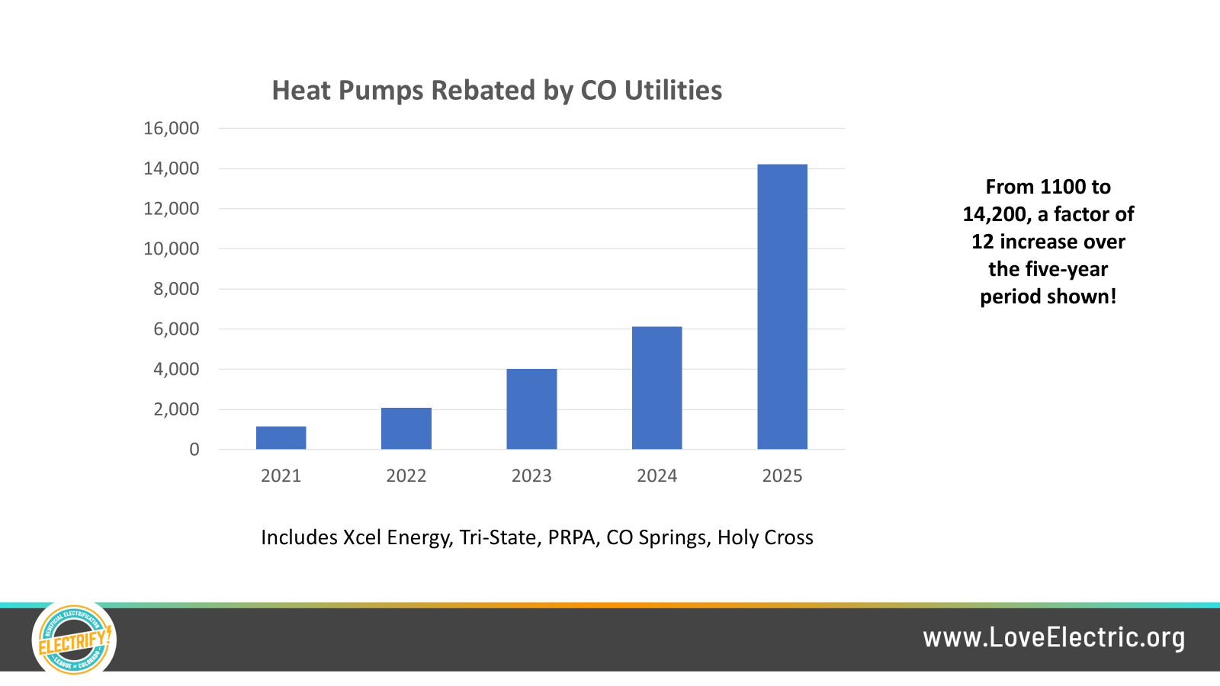

Slide 15
Efficiency Specifications and Requirements
HPWHs
All programs require HPWHs to be ENERGY STAR certified to qualify for incentives
Most HPWHs on market are ENERGY STAR certified, so this is easy to navigate!
ENERGY STAR product finder can be used to verify products are certified
https://www.energystar.gov/productfinder/product/certified-heat-pump-water-heaters/results

Slide 16
Efficiency Specifications and Requirements
Air source heat pumps for HVAC
Not all programs in Colorado are aligned on specification requirements!
If you are trying to stack multiple incentives, make sure equipment qualifies for all programs used
Example below is just for cold-climate, non-ducted ASHPs
Incentive Program | SEER2 | EER2 | HSPF2 | Other
Xcel Energy | 16.0 | 9.0 | 9.5 | COP>=1.75 at 5F, 70% capacity at 5F
Efficiency Works | 21.0 | – | 9.5 | Cold-climate certified by ES, NEEP, CEE, AHRI
Tri-State cooperatives | 15.2 | – | 7.8 | Does not have higher tier rebate for ccASHPs
Colorado Springs Utilities | 15.0 | – | 8.5 | NEEP Certified, COP>=1.75 at 5F
Holy Cross Energy | – | – | 10.0 | COP>=1.75 at 5F, 70% capacity at 5F
La Plata Electric Assoc. | – | – | 8.5 | Does not have higher tier rebate for ccASHPs
HEAR | 15.2 | – | 8.5 | COP>=1.75 at 5F, 70% capacity at 5F

Slide 17
Efficiency Specifications and Requirements
Now let’s look at ducted or partially ducted systems
Example below is just for cold-climate, ducted or partially ducted ASHPs
  Generally closer alignment for ducted equipment requirements
Incentive Program | SEER2 | EER2 | HSPF2 | Other
Xcel Energy | 15.2 | 10.0 | 8.1 | COP>=1.75 at 5F, 70% capacity at 5F
Efficiency Works | 15.2 | – | 8.1 | Cold-climate certified by ES, NEEP, CEE, AHRI
Tri-State cooperatives | 15.2 | – | 7.8 | Does not have higher tier rebate for ccASHPs
Colorado Springs Utilities | 15.0 | – | 8.5 | NEEP Certified, COP>=1.75 at 5F
Holy Cross Energy | – | – | 9.0 | COP>=1.75 at 5F, 70% capacity at 5F
La Plata Electric Assoc. | – | – | 8.5 | Does not have higher tier rebate for ccASHPs
HEAR | 15.2 | – | 8.1 | COP>=1.75 at 5F, 70% capacity at 5F

Slide 18
Contractor Lists
In Colorado today, there are two primary types of contractor lists
“Closed” programs - contractors need to enroll, get on the list in order to access rebates
Voluntary lists - to help homeowner or generate leads for contractors
Closed programs (must be enrolled to access incentives)
Xcel Energy ducted heat pump rebate program, Efficiency Works rebate program
HEAR program run by Colorado Energy Office, State of Colorado HP tax credit program
Voluntary Lists (no contractor needs to join)
Love Electric / BEL-CO Qualified Heat Pump Installer List
Power Ahead Colorado Contractor Hub and Contractor Finder
Some utilities have Preferred Installer lists

Slide 19
Love Electric Qualified Heat Pump Installer List
Access on Love Electric Website (or directly via this link: https://app.hvacree.net/LoveElectric)
Provides homeowners with a directory to search for HVAC heat pump installers
  Search by county service area
  Narrow list down by programs (e.g. utility rebate programs, CCEF financing, etc.)
Why should contractors get on the list?
No cost to join
Can hopefully generate leads for more heat pump projects
Why should homeowners use the list?
We verify that contractors have met minimum training requirements
Let’s you easily search across multiple programs

Slide 20
Love Electric Qualified Heat Pump Installer List
Requirements for contractors to join the list:
Demonstrate that you have a NATE Certificate or have completed an Energy Skilled Certified Heat Pump Installer or Comfort Advisor course, OR
Demonstrate that you are already enrolled in the Xcel ducted heat pump or Efficiency Works heat pump rebate programs, OR
Pass the BEL-CO Heat Pump Assessment and demonstrate completion of a heat pump course within the past 12 months
To stay on the list, each year you must:
Remain in good standing with Xcel / Efficiency Works (if you qualified using that pathway)
Demonstrate that you received at least 1 heat pump rebate or heat pump QI bonus last year
Demonstrate that you attended at least 1 heat pump course or webinar last year
Find all info here: https://loveelectric.org/qualified-contractor-lists/

Slide 21
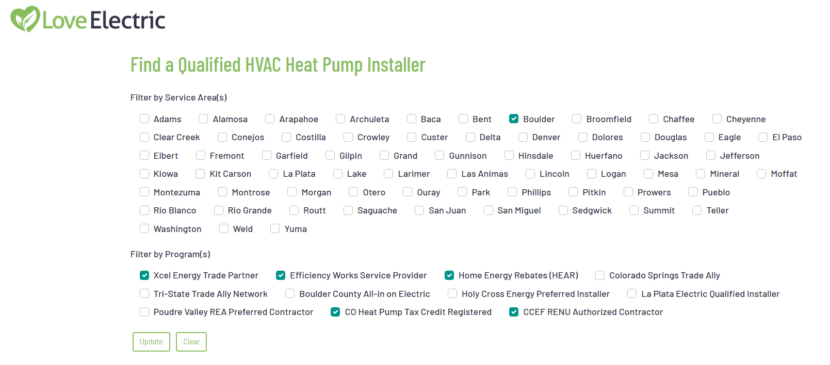
Love Electric Qualified Heat Pump Installer List

Slide 22
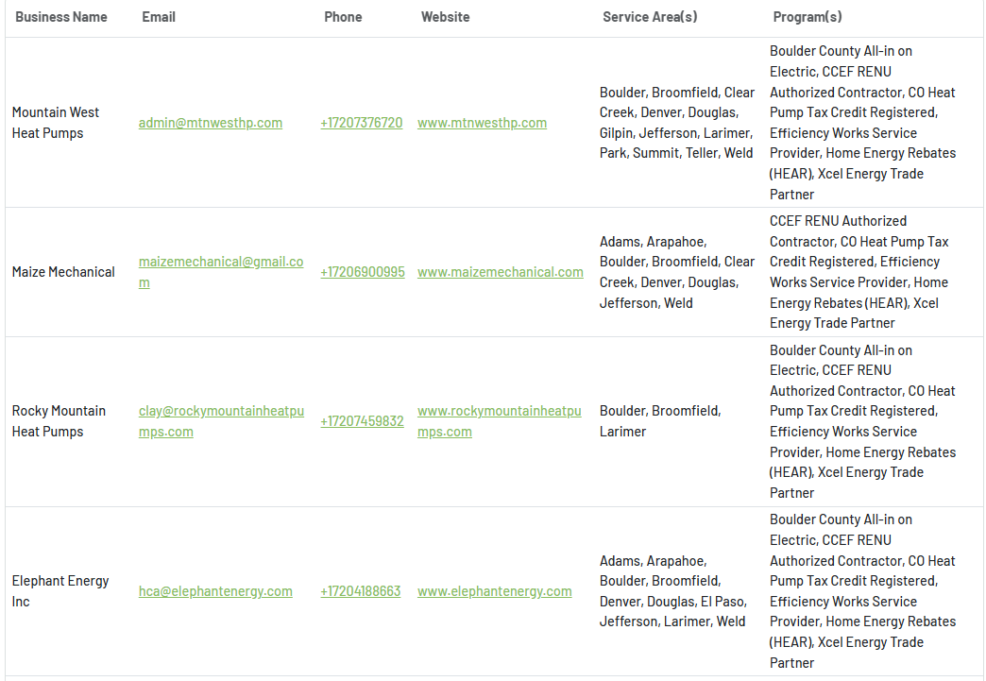
Love Electric Qualified Heat Pump Installer List

Slide 23
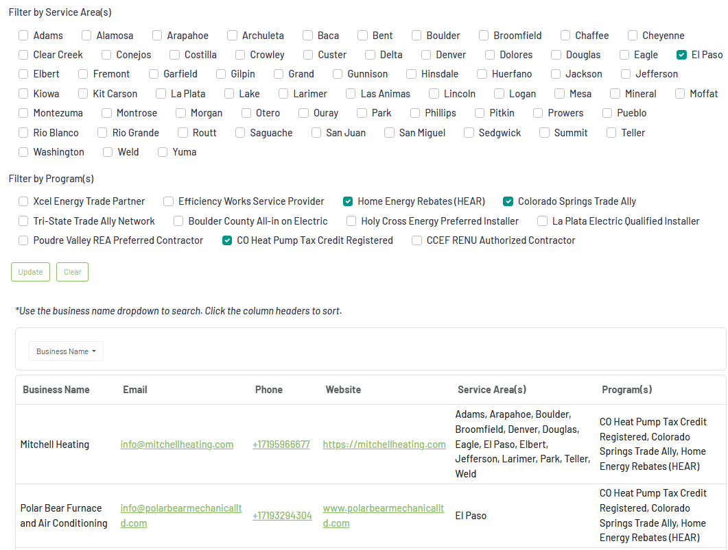
Love Electric Qualified Heat Pump Installer List

Slide 24
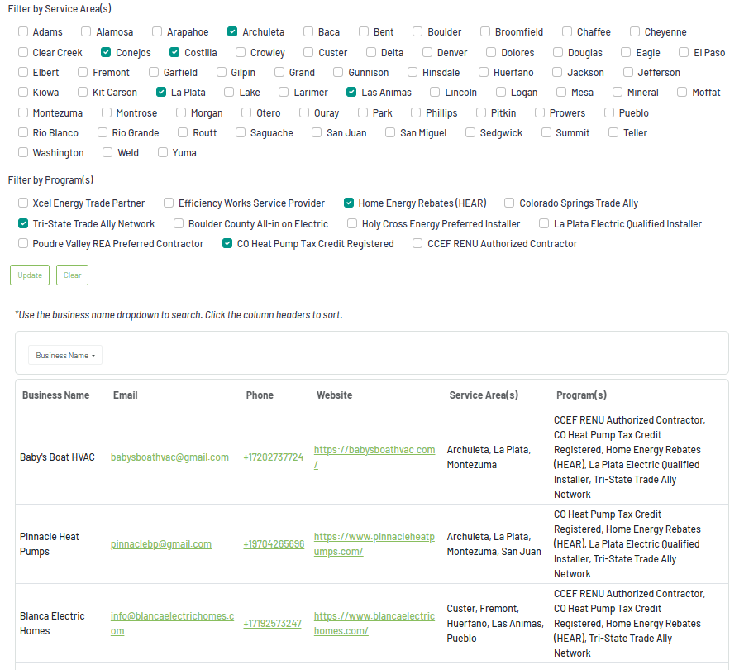
Love Electric Qualified Heat Pump Installer List

Slide 25
Love Electric Contractor Resources
Contractors can access free webinar resources here: https://loveelectric.org/technical-resources/
Load calculations for heat pumps in Colorado
Sizing and selecting heat pumps in Colorado
Air flow measurement and commissioning for heat pump systems
Refrigerant charging and commissioning for heat pump systems
Heat pump water heater installation basics for Colorado
We try to host webinars with info that specifically addresses the challenges that Colorado contractors face

Slide 26
Love Electric Contractor Resources
We also maintain a list of upcoming training events here: https://loveelectric.org/upcoming-training-events-and-webinars/
Upcoming hands on heat pump training events hosted by:
La Plata Electric (March 24)
Y-W County REA (April 1)
Morgan County REA (April 2)
Xcel Energy (Denver, April 28), (Pueblo, April 14), (Silverthorne, April 16), (Glenwood Springs, May 20)
Colorado Springs Utilities (March 26)

